Slide 1
Global Webinar for Third-Party Providers/Complementors
Presentation will begin at 12:03GMT
If you cannot hear us via WebEx / computer audio
you may need to dial-in using a phone
July 2023
James Moore
Complementors Team

Slide 2
Agenda
Admin notices
RMA Bootstrap by Raphael Iglesias Espino
Swift Public Cloud Deployment by Sophie Racquet
Transaction Manager – Abort Function by Damien Vanderveken
Enterprise Testing Solution by Keith Boldeau
Close
July 2023

Slide 3
Admin notices
This presentation is being recorded
The content will be published on SWIFT.com (https://www.swift.com/standards/iso-20022/iso-20022-past-webinars)
Global webinar for third-party providers occur the last Thursday of every month and you can register 2 weeks before each event here: Global Webinar for Third Party Providers/Complementors
To ensure you receive communications from us while we remain GDPR compliant please update your preferences here (you will need to login to / create your free SWIFT account) to include the interests ‘Payments’ and/or ‘Standards’ and we will ensure we keep you informed about:
Global webinar for third-party providers Invitations
Relevant developments on ISO 20022 and Transaction Management
Updates from SWIFT’s Market Practice team
The latest info on adoption enabling tools and support
Support requests / queries should be raised via the Support page
Queries regarding gpi portfolio certification/ self-attestation processes should be directed to new e-mail address: provider.readiness@swift.com
July 2023

Slide 4
RMA Bootstrap

Slide 5
CBPR+ release of November 2023 – Deployment plan
Dec 2022
24 Feb 2023
19 May 2023
23 July 2023
19 Nov 2023
Initial Usage Guidelines published on MyStandards
Final Usage Guidelines
published on MyStandards
Deployed
in FINplus
ITB Future
Deployed
in FINplus Pilot Future
Generally available in FINplus Live and Pilot Current
Vendor Testing on ITB
Customer Testing on Pilot
The CBPR+ Usage Guidelines for November 2023 can be found here in MyStandards, along with a new, dedicated Readiness Portal.
The Translation Portal was updated on 16 June 2023.
Scope
camt.055 | Customer Payment Cancellation Request | New | -
camt.058 | Notification to Receive Cancellation Advice | MT 292 | In-flow
camt.107 | Cheque Presentment Notification | MT 110 | In-flow
camt.108 | Cheque Cancellation or Stop Request | MT 111 | In-flow
camt.109 | Cheque Cancellation or Stop Report | MT 112 | In-flow
pacs.003 | FI to FI Customer Direct Debit | MT 107 | -
pain.008 | Customer Direct Debit Notification | MT 104 | -
pacs.010 | Financial Institution Direct Debit (*) | MT 204 | -
 | (*) Scenario specific to Central Counterparty (CCP) for margin collection

Slide 6
Page 6
RMA bootstrap for CBPR+ Portfolio 2023 (Planned for Sept 2023)
RMA Bootstrap | If authorised in FIN | Then authorise in FINplus | Message Name
Mandatory bootstrap | MT 110 | camt.107.* | ChequePresentmentNotification
 | MT 111 | camt.108.* | ChequeCancellationOrStopRequest
 | MT 112 | camt.109.* | ChequeCancellationOrStopReport
 | MT 292 | camt.058.* | NotificationToReceiveCancellationAdvice
Optional bootstrap (via e-orders) | MT 941 / MT 942 | camt.052.* | BankToCustomerAccountReport
 | MT 940 / MT 950 | camt.053.* | BankToCustomerStatement
 | MT 900 / MT 910 | camt.054.* | BankToCustomerDebitCreditNotification
The mandatory bootstrap is expected to be performed in Q3 2023
See FINplus RMA bootstrap (2023) https://www2.swift.com/knowledgecentre/kb_articles/5024914
The E-order form for optional bootstrap is expected to be made available in Q2 2023
Notes:
RMA is a mandatory prerequisite to exchange Live traffic with your counterparties. To ensure a transparent adoption of ISO 20022 and to enable freedom in choice of channel, institutions will be required to keep RMA relationships synchronised across FIN and FINplus at all times. This is the main driver of the RMA Evolution project, which is based on following principles:
Providing a synchronised starting point for all, by bootstrapping FINplus RMA relationships based on the equivalent FIN ones.
Ensure automatic synchronisation by moving to a central management model using the new RMA Portal.
The new messages introduced for November 2023 portfolio will be subject to RMA on FINplus. As indicated on the slide, for the first 4 messages, Swift will perform a mandatory RMA bootstrap based on FIN equivalent RMAs. This is expected to happen in Q3 2023.
For the last 3 messages on the list – camt.052, camt.053 and camt.054, we will offer another opportunity for customers to opt in for the (optional) bootstrap through a dedicated e-order form. You would notice that these 3 messages have been implemented for March 2023 and some of you would have already completed bootstrap last year for these messages. This is a new opportunity for the customers who did not do it last year and want to be part of the bootstrap of these messages this year. The E-order form for optional bootstrap is expected to be made available to the community in Q2 2023.
For the rest of the new messages from November 2023, no RMA bootstrap is foreseen. Customers will need to add them by themselves, either on the central RMA portal or local RMA depending on what they are using.

Slide 7

RMA Readiness for November 2023
Apr 2022
RMA Portal
available to all
July 2022
Initial
RMA Bootstrap
Mar 2023
Start of CBPR+
coexistence
Mar 2023
Central
Management
Available
May 2023
Opt-in e-form
available for
optional bootstrap
July 2023
Due date
opt-in for
optional bootstrap
Sep 2023
RMA Bootstrap
(incl. optional scope)
Nov 2023
Extra CBPR+
messages Go-Live
Continued sync and consistency checks FIN / FINplus
Window for opt-in for optional bootstrap camt messages
Window for importing bootstrapped records
Please consult RMA Portal – Getting Started for information on
FINplus RMA Bootstrap
camt Report Bootstrap
Consistency Checks
Central management features
Central RMA management activation
Connect to the RMA Portal (WebAccess)
Review bootstrapped records in RMA Portal
Review & reconcile records in RMA Portal
Extract FIINplus bootstrap, distribution file from RMA Portal
Import FINplus bootstrap distribution file into local RMA interface
Migrate to central management through the RMA Portal by end 2023.
Central RMA management available since Ma 2023

Slide 8
Activities to ensure RMA readiness for November 2023
For more details and supporting material,
visit the RMA Support page.
 | Activity | Reference
 | Adhere to consistency check rules for cross-channel authorisations | RMA getting started guide
1 | Set up access to central RMA Portal | RMA getting started guide
2 | Validate centrally stored authorisations | RMA validation guidelines
3 | Extract the distribution file from the central RMA Portal and Import 2023 bootstrapped FINplus | RMA Service Operation Guide
 | Activate central RMA Management for pilot and live services | Central Management RMA Activation
Alliance Lite2 and Alliance Cloud users are invited to consult their dedicated Customer Adoption Guide for more specific instructions.
Notes:
This slide lists the exact steps to take for generating and importing your FINplus RMA distribution file.
<How do you want to cover this slide? Rapid list of steps or explain one by one?>
For each, we have included a direct link to the exact supporting section in the documentation available on the Knowledge Centre. If you need further information, check the resources available on the RMA Support page on mySWIFT: the link is in the upper right corner of the slide.

Slide 9
Swift Public Cloud Deployment

Slide 10
A growing shift to the cloud
Complementors
85%
66%
3000+
Firms adopting a cloud-first strategy by 2025, according to Gartner
The market share of Swift approved IaaS providers
Customers leveraging Swift’s SaaS offerings

Slide 11
Why are our customers considering cloud?
More and more firms are leveraging its agility and scalability
Cloud first strategy at company level
End of data centre contracts
Reduce total cost of ownership by minimising infrastructure, maintenance and resources costs without compromising on security and availability
Customers without a data centre and limited Swift knowledge or expertise expect SaaS and IaaS solutions from Swift
Latest cloud-based back-office applications
Disaster-recovery capabilities in the cloud
Difficulty to access data centre for maintenance activities
Customers with their back-office purely on cloud require Swift VPNs deployed on public cloud without hardware requirements
Customers lacking Swift operational expertise want to minimise involvement in operating Swift infrastructure
Banks can run operations across the world without having to access data centres

Slide 12



Swift’s public cloud deployment
An overview
Infrastructure as a Service (IaaS)
Public cloud deployment
Hosting in the public cloud of the Swift messaging and connectivity software
SDK/MGW
Alliance Access
AMH
Alliance Warehouse
Swift messaging and connectivity software managed and operated by the customer
SNL/SAG
Alliance Lite2 (AutoClient)
AGI
Alliance Cloud
(SIL)
Alliance Connect Virtual to connect to Swift network from the public cloud
VPN Alliance Connect Virtual
Alliance Connect Virtual managed and operated by Swift
Cloud providers provide cloud environment for the deployment of the Swift components

Slide 13





Alliance Connect Virtual
Alliance Connect Virtual
Deploy your Swift VPNs virtually on public cloud infrastructure
Features
Benefits
Connect to Swift from VPNs deployed on public cloud
Secure and reliable
Available in bronze, silver, gold i.e. choice of internet or leased line connectivity
Ease of deployment
Ease of management and monitoring
Managed by Swift
Faster time to market
Network partner leased line connectivity included
Global availability
Simpler monthly fee model

Slide 14


Alliance Connect Virtual Bronze topology
End to end cloud stack offering
Integration between the virtual VPN (vSRX) and the cloud provider Virtual trust Platform Module to provide FIPS L2 compliancy
Dual VPN connecting via internet connectivity forms the basis of Full scope Alliance Connect Virtual solution
High-Availability script (HA) from Swift deployed on a Virtual Machine. The HA script is polling the 2 vSRX instances and ensure that the customer traffic is routed to a vSRX instance that is reachable
* Virtual Trust Platform Module
** Cloud providers will give reasonable assurance to customers that the control objectives for which they are responsible are met
***Swift Microgateway is a ready to use API Proxy and Swift SDK is a java-based API library for consuming Swift Services over APIs
Customer app subscription
Customer VPN Subscription
Swift OPC
Micro-gateway/ SDK***
HA
VSRX
Internet
Cloud provider access network
Swift
BAP
VM
Availability zone 1
VM
VM
HA
VSRX
Swift
BAP
VM
Availability zone 2
VM
API gateway
VTPM*
Customer managed and controlled
In scope of CSP** (customer attestation)
Swift managed connectivity

Slide 15
Alliance Connect Virtual
General availability timeline and where to get more info
MVP
MVP
GOLD/Silver/Bronze
GOLD / SILVER / BRONZE
GOLD / SILVER / BRONZE
August 2023 **
May 2024 *
Available
Available
Available
2022 / 2023 / 2024
*MVP: Single VPN instance connecting via internet, ** Tentative, pending successful qualification
***Leased line bandwidth up to 2Mbps ****except ESMIG/TIPS, Webserver, AU-NPP
Notes:
Sophie

Slide 16

Key customer considerations
Customer adopting public cloud for Swift solution implementation shall carefully define the cloud deployment strategy with key elements of security, resiliency performance into consideration
Security
Resiliency
Performance
Cloud provider selection
Business applications
User access controls & monitoring
End-to-end deployment architecture
CSP adherence & attestation
Multiple connectivity packs
Multi cloud & intra-cloud zones setup
Disaster Recovery mechanism
Hardware based connectivity backup
Solution design – Full/Hybrid
Latency measurement
End-2-end connectivity
Resources availability & scalability
Choice from three(3) cloud providers (Azure, AWS , GCP)
Deployment ease & reliance
Geographical presence & operational ease
Local/ industry regulatory compliance

Slide 17
Conclusions
Connect your cloud- native back office applications to any of the Swift’s infrastructure, including ITB
Leverage the Agility of ACV for standard release and certification testing
Support customer’s strategy to move to public cloud with ease
Need further information – reach out to your account manager!

Slide 18
Transaction Manager Abort - Reminder

Slide 19



Business validations
Message validation and aborts
Sender
A
B
NEW
C
Receiver
Network
Validation
Business
Validation
Delivery
Notification
MT
ISO
NAK
ABORT
xsys.012 on FINplus
MT 019 on FIN
A
Not in scope of this Tip
B
NEW
C
Not in scope of this Tip
CBPR+ messages are validated by the FINplus service against the CBPR+ Usage Guidelines, plus other generic InterAct controls. The sender receives NAK responses in case of validation failures.
For more details, see the SWIFTNet Link Error Codes document.
The sender can receive abort (xsys.012 or MT 019) messages related to extra I. business validation rules as well as II. technical validation introduced by Transaction Manager such as
Unique End-To-End Identification (EndToEndId) and Transaction Identification (TxId) passed on, unchanged for Customer Credit Transfers, throughout the entire end-to-end transaction chain
Concordance of key elements between the payment advice and the cover messages
For more details, please refer to next slides
The FINplus service also sends back abort (xsys.012) messages to the sender in case of issues with the delivery of the message to the recipient (MT 019 on FIN).
Most common cases:
The recipient failed to acquire the message for 14 days.
Too many failed attempts to deliver the message on the recipient’s queue.
For more details on abort messages and other system messages, see the SWIFTNet 7.6 System Messages document.
Important
From November 2023, the FINplus service also controls for UETR recycling and validity of Service Type Identifier (STI). NAK responses will be generated in case of validation failures too.
For more details, see the TIP 5023810

Slide 20
Business validations
Message validation and aborts
Sender
A
B
NEW
C
Receiver
Network
Validation
Business
Validation
Delivery
Notification
MT
ISO
For Service Bureaus
NAK
In the past 30 days, 2,000+ MX messages were aborted due to non-delivery to receiver
25% (500+ messages) are managed by 12 Service Bureaus, some having more than 5 customer BICs failing to receive MX on FINplus
ACTION for SB: verify the SwiftNet FINplus configuration on SAG and Interface to guarantee that the FINplus queues are properly acquired and successfully drained
ABORT
xsys.012 on FINplus
MT 019 on FIN
A
Not in scope of this Tip
B
NEW
C
Not in scope of this Tip
CBPR+ messages are validated by the FINplus service against the CBPR+ Usage Guidelines, plus other generic InterAct controls. The sender receives NAK responses in case of validation failures.
For more details, see the SWIFTNet Link Error Codes document.
The sender can receive abort (xsys.012 or MT 019) messages related to extra I. business validation rules as well as II. technical validation introduced by Transaction Manager such as
Unique End-To-End Identification (EndToEndId) and Transaction Identification (TxId) passed on, unchanged for Customer Credit Transfers, throughout the entire end-to-end transaction chain
Concordance of key elements between the payment advice and the cover messages
For more details, please refer to next slides
The FINplus service also sends back abort (xsys.012) messages to the sender in case of issues with the delivery of the message to the recipient (MT 019 on FIN).
Most common cases:
The recipient failed to acquire the message for 14 days.
Too many failed attempts to deliver the message on the recipient’s queue.
For more details on abort messages and other system messages, see the SWIFTNet 7.6 System Messages document.
Important
From November 2023, the FINplus service also controls for UETR recycling and validity of Service Type Identifier (STI). NAK responses will be generated in case of validation failures too.
For more details, see the TIP 5023810

Slide 21



Transaction Manager business validation overview
Swift have been monitoring live traffic since the start of the CBPR+ coexistence period to assess the expected impact of the new business validation and data integrity rules Transaction Manager activation will introduce. The findings of this analysis shows that the expected rate of abort would be a very small fraction of live traffic. The main reasons for aborts or bypasses are as follows:
Context | Business Validation Breach | TM behaviour
All messages in scope | UETR re-use | Bypass
Cover scenarios | CCT: Cover/ Advice: non-matching key data elements | Abort
 | FICT: No UDLC code for FICT Cover | Abort
 | Unexpected message type | Abort or Bypass
 | Invalid Instruction ID or Invalid End-To-End ID ("NO REF" or "NON REF" or "NOT PROVIDED") | Bypass now and Abort in November 2023
 | Non matching references (Cover) Instruction ID is different from End-To-End ID | Bypass
Customers should prioritise investigating and correcting any elements of their CBPR+ implementation that will result in an abort
Learn more:

Slide 22
Transaction Manager Business Validations
Invalid References
Notes:
What happens if a message has an invalid Instruction ID or invalid End-to-end ID?

Slide 23
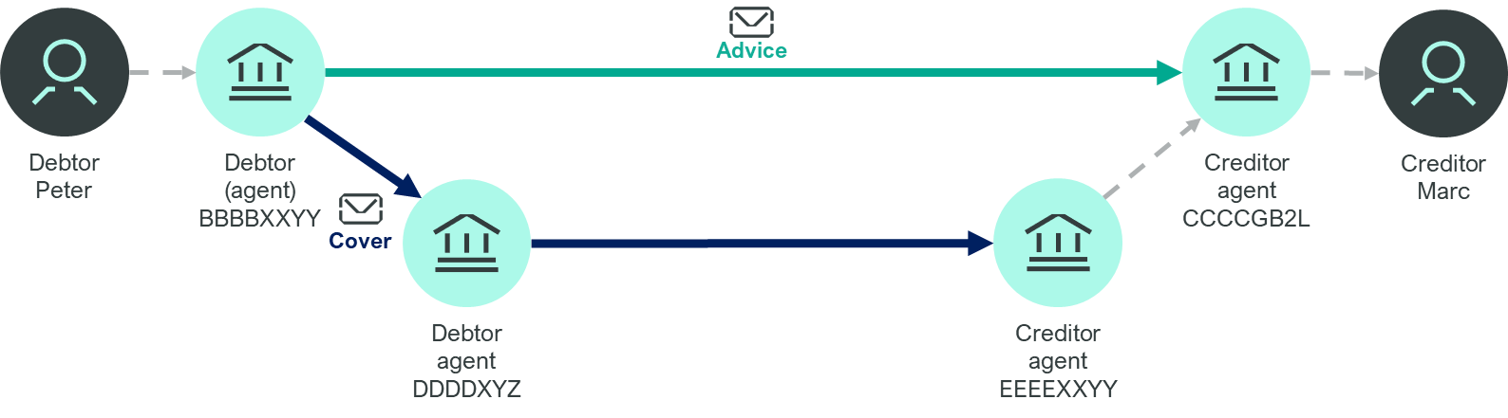

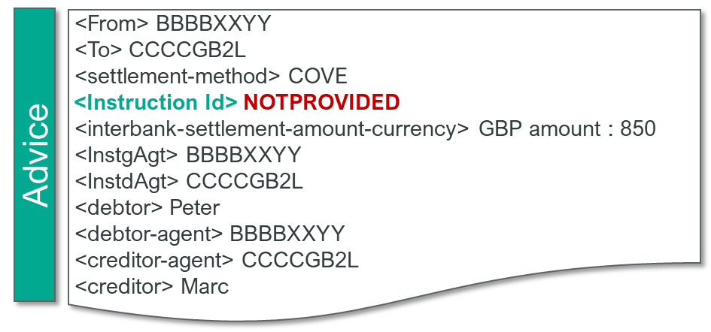

Rule Ref | A-GEN-COV-001A (refer to appendix B.1 for detailed references)
What is wrong? Invalid Instruction ID
When the Cover settlement method is used (for both Customer and Financial Institutions transfers), if a valid Instruction ID is not provided in the Advice Transaction Manager aborts the message.
Out of TM scope for documented example
DDDDXXYZ
pacs.008 with settlement method COVE*
Instruction ID is not valid
*The same validation rule applies to Field 20 from MT 103/ MT 202/ 205 Advice message. The use of string of characters “NONREF, NOREF, NOTPROVIDED” will lead to a TM Abort
abort
Transaction Manager would abort the message
Notes:
In this scenario, an invalid End-to-End ID is populated in both the Advice and the Cover message.
Therefore Transaction Manager will abort the message.
In this particular case, Invalid means that the element contains the string “NOTPROVIDED” or “NONREF”.

Slide 24
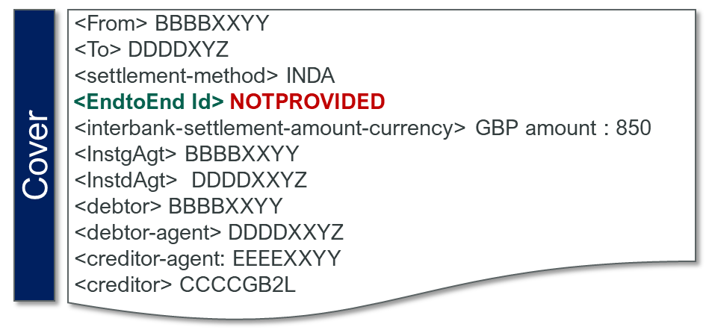
Rule Ref | A-GEN-COV-001B (refer to appendix B.1 for detailed references)
What is wrong ? Invalid End-to-End ID
When the Cover settlement method is used (for both Customer and Financial Institutions transfers), if a valid End-to-End ID is not provided in the cover by the same sender, Transaction Manager aborts the message.
Important Note: Abort implementation postponed to November 2023. Messages will by bypassing TM between May and November 2023.
Out of TM scope for documented example
DDDDXXYZ
pacs.009 COV or pacs.009 Core with code/UDLC/*
DDDDXXYZ
E2E ID is not valid
*The same validation rule applies to Field 21 from MT 202/ 205 Cover message both for CCT and FICT. The use of string of characters NONREF, NOREF, NOTPROVIDED” will lead to a TM Abort
abort
Transaction Manager would abort the message
Notes:
In this scenario, an invalid End-to-End ID is populated in both the Advice and the Cover message.
Therefore Transaction Manager will abort the message.
In this particular case, Invalid means that the element contains the string “NOTPROVIDED” or “NONREF”.

Slide 25


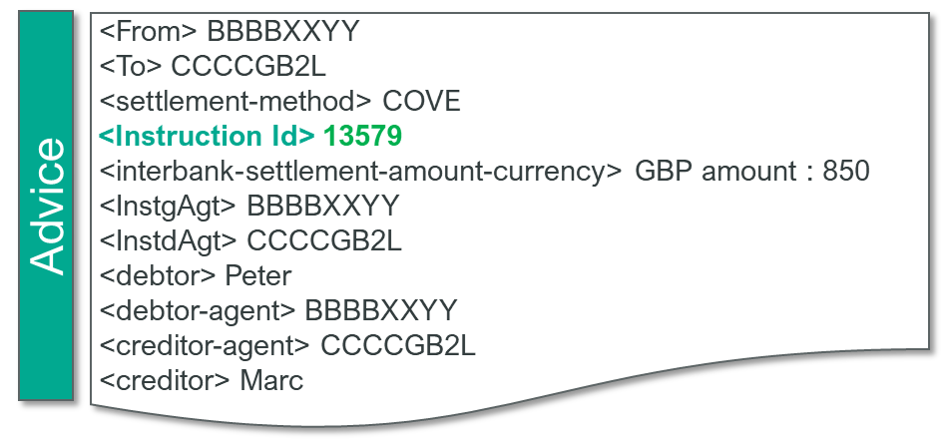

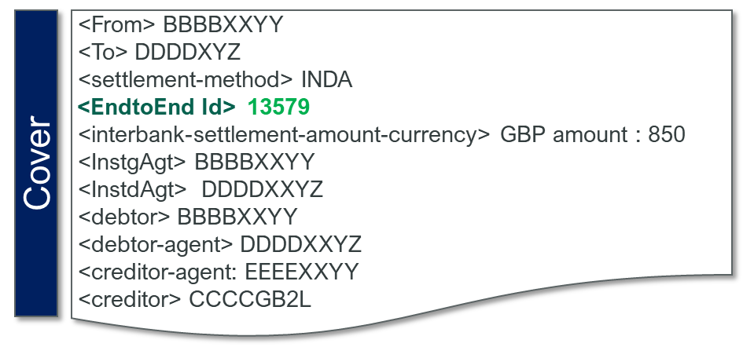

Rule Ref | A-GEN-COV-001B (refer to appendix B.1 for detailed references)
How to correct an Invalid End-to-End ID?
When the Cover settlement method is used (for both Customer and Financial Institutions transfers), a valid End-to-End ID is to be provided in the Cover message by the same sender (for both the Advice and the Cover message) to be processed by Transaction Manager. The End-to-End ID of the cover message should match the Instruction ID of the Advice message.
camt.
Out of TM scope for documented example
DDDDXXYZ
pacs.008 with settlement method COVE or pacs.009 ADV
pacs.009 COV or pacs.009 Core with code /UDLC/
IDs are populated
*The same validation rule applies to Field 21 from MT 202/ 205 Cover message
process
Transaction Manager would abort the message
Notes:
In this scenario - when the Cover method is used -
for both Customer and Financial Institutions transfers -
a valid Instruction ID must be populated in the Advice,
and a valid End-to-End ID in the cover provided by the same sender for the message to be processed by Transaction Manager,
otherwise the message may be aborted.
This is applicable to both ISO 20022 and FIN Cover messages.

Slide 26



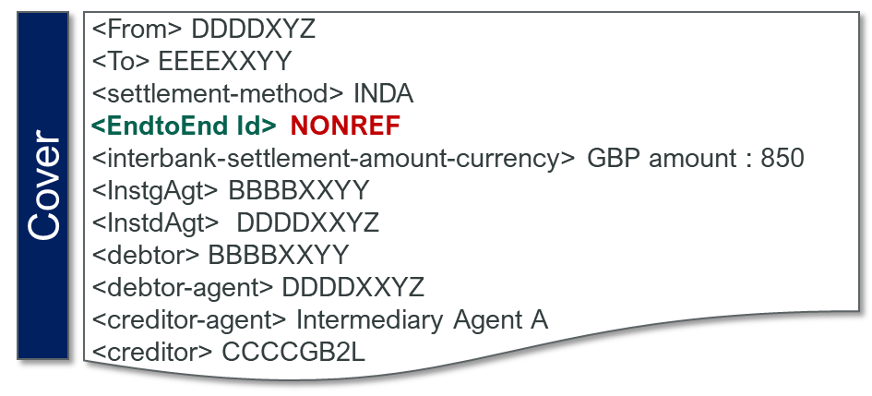
Rule Ref | A-GEN-COV-001B (refer to appendix B.1 for detailed references)
What is wrong? Invalid End-to-End ID
If the Intermediary deletes the valid End-to-End ID from a received Cover leg processed by TM and replaces by an invalid End-to-End ID, Transaction Manager aborts the message.
Out of TM scope for documented example
Important Note: Abort implementation postponed to November 2023. Messages will by bypassing TM between May and November 2023.
DDDDXXYZ
pacs.009 COV or pacs.009 Core with /UDLC/
pacs.009 COV or pacs.009 Core with /UDLC/
ID is replaced by Intermediary
DDDDXXYZ
EEEXXYY
EEEXXYY
EEEXXYY
CCCCGB2L
*The same validation rule applies to Field 21 from MT 202/ 205 Cover message The use of string of characters NONREF, NOREF, NOTPROVIDED” will lead to a TM Abort
abort
Transaction Manager would abort the message
Notes:
In this scenario, the first Cover leg, with a valid End-to-End ID is processed correctly by Transaction Manager, however the Intermediary deletes the valid End-to-End ID and replaces it by with an an Invalid End-to-End ID, therefore Transaction Manager aborts this Cover message.
If Transaction Manager is unaware of leg 1, for instance it is passed through an MI, then Transaction Manager would bypass leg 2 if the Cover message contains an invalid E2E ID. (ES: need to check that “MI” is acceptable as an acronym in voiceover terms, or whether we need to say the long version)

Slide 27
Rule Ref | A-GEN-COV-001B (refer to appendix B.1 for detailed references)
How to correct an Invalid End-to-End ID?
When a Cover Intermediary receives a valid End-to-End ID in a received Cover leg processed by TM it should keep it unchanged when forwarding the message to the next Cover agent.
Out of TM scope for documented example
DDDDXXYZ
pacs.009 COV or pacs.009 Core with /UDLC/
pacs.009 COV or pacs.009 Core with /UDLC/
E2E ID is forwarded unchanged by Intermediary
123456
DDDDXYZ
EEEXXYY
CCCCGB2L
EEEXXYY
*The same validation rule applies to Field 21 from MT 202/ 205 Cover message
process
Transaction Manager would abort the message
Notes:
In this scenario, the first Cover leg is processed correctly by Transaction Manager.
However the Intermediary has deleted the valid ID and replaced it with an Invalid End-to-End ID.
Therefore, Transaction Manager will abort this Cover message.
Alternatively, when Transaction Manager is unaware of leg 1
- for instance when it has passed through a Market Infrastructure -
then Transaction Manager will bypass leg 2 when the Cover message contains an invalid E2E ID.

Slide 28
Transaction Manager Business Validations Key Data Mismatch
Notes:
What happens when there is a key data mismatch in cover messages for customer credit transfers?

Slide 29
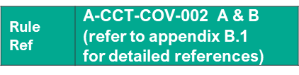
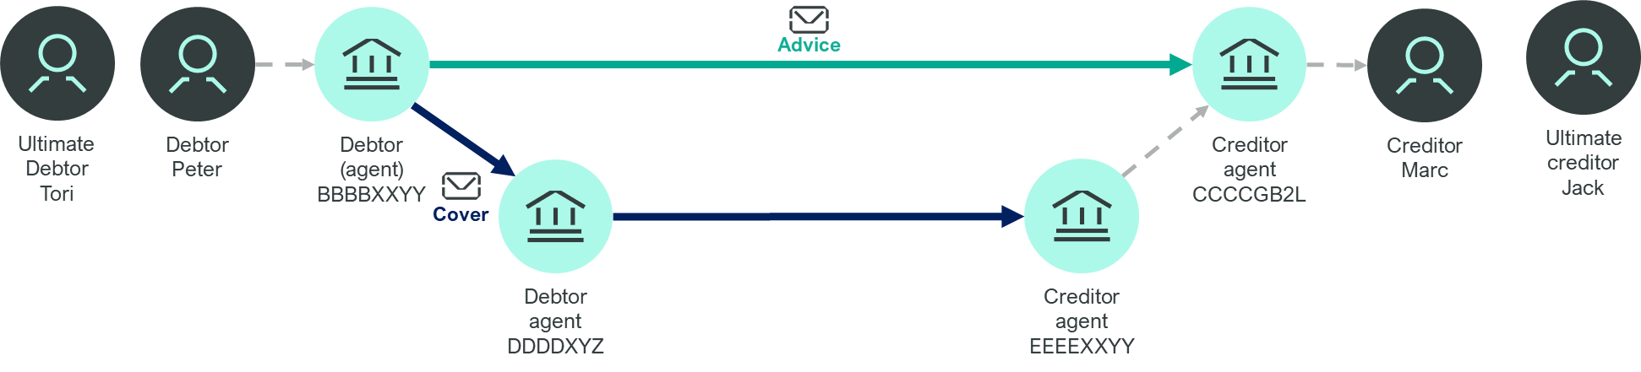
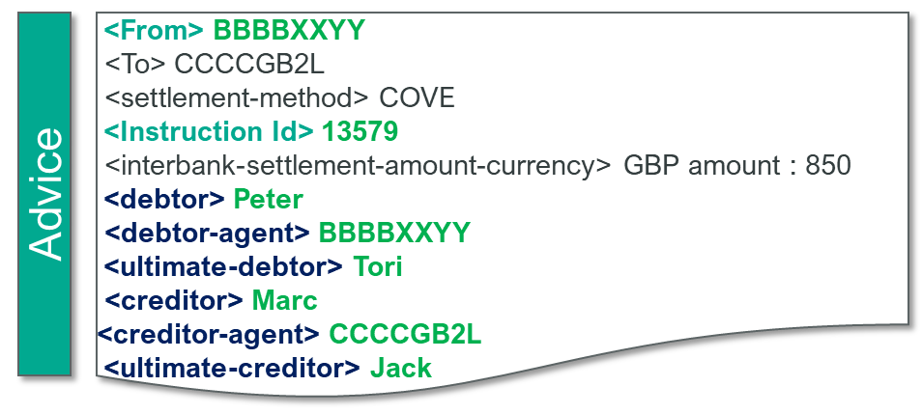
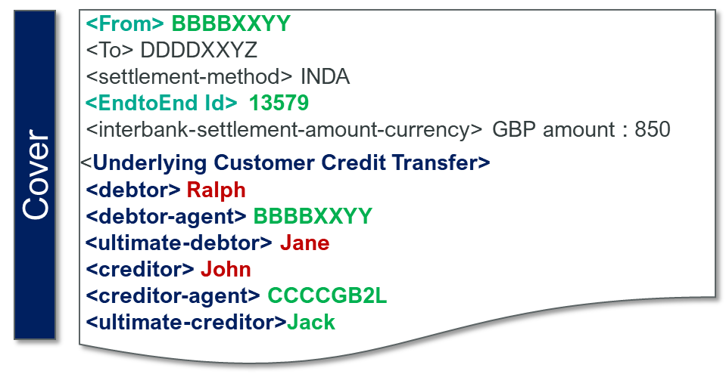
What is wrong? Key Data Mismatch between the Credit Transfer Advice message and the Cover message
The same sender sends a Credit Transfer Advice and Cover messages. If the key data included in the Cover (identified with a matching E2E ID) and Advice messages do Not match, Transaction Manager aborts the second message.
camt.
Out of TM scope for documented example
DDDDXXYZ
pacs.008 with settlement method COVE
pacs.009 COV*
Key data elements mismatch
* In case both underlying Creditor and Debtor as well as one additional key data element (Debtor Agent or Creditor Agent or Ultimate Creditor or Ultimate Debtor) are different, TM aborts the second message. The same validation rule applies to the equivalent fields for the MT 103 and MT 202/ 205 Cover message.
abort
Transaction Manager would abort the message
Notes:
If at least 3 of these data elements do not match, the second message is aborted by TM.
In this example, the end-to-end ID, the ultimate debtor and the ultimate creditor are not matched.
Therefore, Transaction Manager will abort this message.

Slide 30
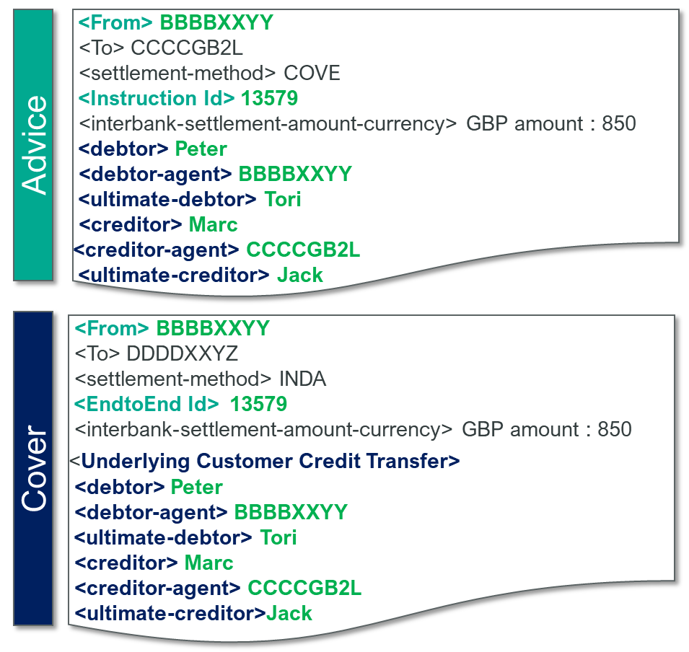
How to correct Key Data Mismatch between CCT Advice and Cover messages ?
Step 1
sender (BIC11) of both messages is the same
InstructionIdentification (Advice) matches EndToEndIdentification (Cover)
Key data elements considered to identify a cover scenario with Instruction ID from Advice message matching End-to-End ID from Cover message (step 1) then further key data elements from the underlying CCT of the Cover message are compared with the advice to identify if there are any mismatches in key data elements (step 2)
Step 2
Debtor AND Creditor AND
Debtor-Agent OR Creditor-Agent OR Ultimate-Debtor OR Ultimate-Creditor
Key Data Matches
process
Transaction Manager would abort the message
*The same validation rule applies to the equivalent fields for the MT 103 and MT 202/ 205 Cover message
Notes:
Transaction Manager compares the key data elements
- from messages received from the same agent -
with the previous message processed by Transaction Manager to validate whether the two messages represent a cover initiation.
In a Customer Credit Transfer Cover settlement method scenario,
the Cover message sent by the same sender contains an end-to-end ID that matches the Instruction ID from the Advice message.
Transaction Manager also checks whether the key data elements in the Underlying Credit Transfer element match the same elements in the Advice message.
In this example the data matches, and therefore it will be processed.

Slide 31
Transaction Manager Business Validations Unexpected Message Type – Same Sender
Notes:
What happens when there is an unexpected message type from the same sender?

Slide 32
Unexpected Message Type from the Same Sender
The tables provide a high-level summary of the use cases for cover scenarios when a message is sent from the same agent for both Customer Credit Transfers (CCT) and Financial Institution Credit Transfers (FICT) and when the message is clearly identified as a Cover message (based on matching of key data elements^{)1.} The combination of the messages indicated in red lead Transaction Manager to Abort the second message sent by the same sender.
 | First message type processed by TM | Subsequent message typed from the same agent
CCT |  | pacs.009 COV | pacs.009 ADV |  | pacs.009 (CORE) | pacs.009 (CORE) | pacs.008
 | pacs.008 (inc STP) | Process | Abort |  | Abort | Abort | Bypass
 | pacs.009 COV | Bypass | Abort |  | Abort | Abort | Process
FICT |  | pacs.009 (CORE) with UDLC | pacs.009 COV | pacs.009 ADV |  | pacs.008 | pacs.009 (CORE) without UDLC
 | pacs.009 ADV | Process | Abort¹ | Bypass |  | Abort | Abort
 | pacs.009 (CORE) without UDLC | Abort | Abort | Bypass |  | Abort | Bypass
 | pacs.009 (CORE) with UDLC | Bypass | Abort | Process |  | Abort | Abort
¹ Abort in case of unexpected message type is only triggered if (1) E2E ID from Cover message matches Instruction ID from Advice message (otherwise second message is bypassing TM) & (2) Cover Creditor should also be the receiver of the Advice message. For further details please refer to the “Business Processing Rules” in section 6.2.13
Note: Abort rules apply to both MX and MT equivalent messages except for rule on UDLC code
Notes:
To validate whether the two messages represent a cover initiation, Transaction Manager compares the key data elements from the second message.
- received from the same agent - when the previous message is already processed by Transaction Manager.
This Table provide a high-level summary of the cover scenarios for both Customer Credit Transfers (CCT) and Financial Institution Credit Transfers (FICT).
(for example, pacs.009 (CORE) sent to cover the funds for pacs.008 (settlement method COVE) would be an incorrect combination).
Transaction Manager will also abort a transaction when an unexpected message type is sent as part of a Cover settlement by the same sender.
This also applies to FIN messages.

Slide 33
Transaction Manager Business Validations Financial Institution Cover Settlement UDLC Codeword
Notes:
Let’s go over a few scenarios that can result in Aborts or Bypasses:
First: what happens when the UDLC codeword for Financial Institution Credit Transfer Cover Settlement is incorrect?

Slide 34
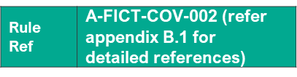
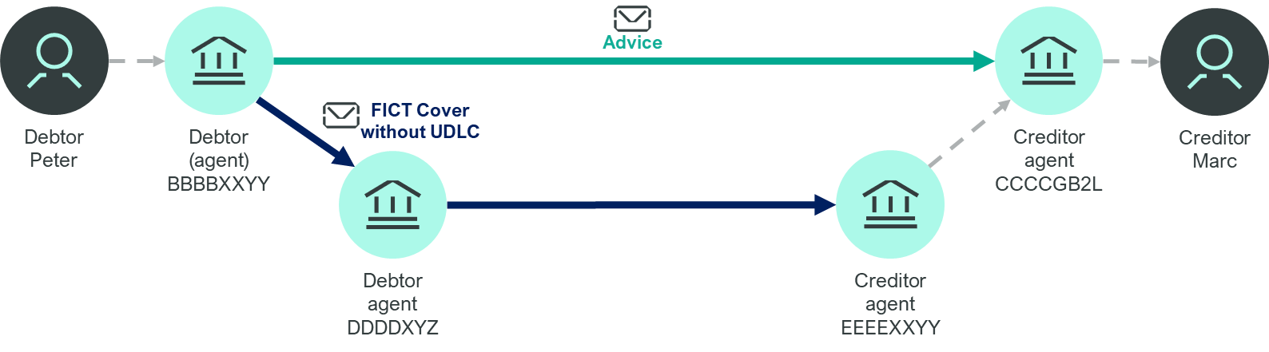

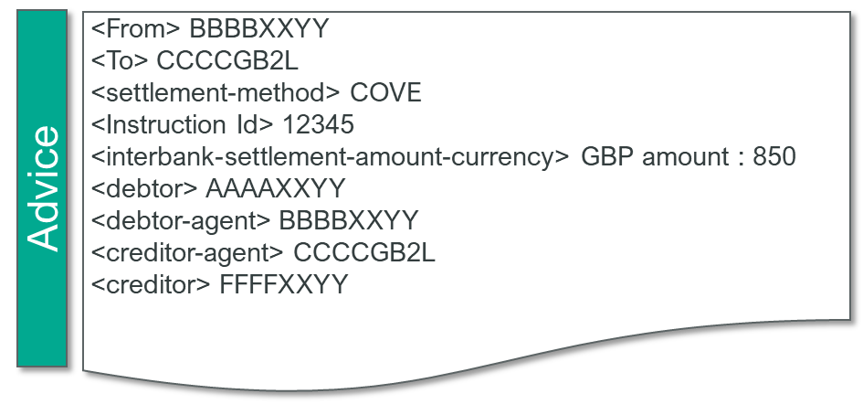
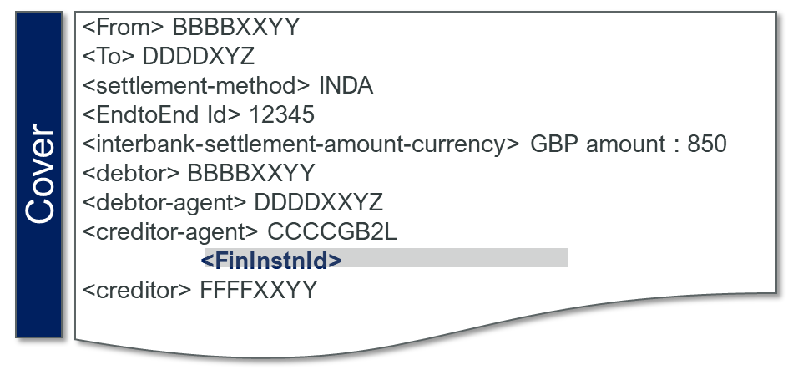
What is Wrong? UDLC Codeword not present (ISO 20022 messages only)
Where a pacs.009 (CORE) is used to settle the pacs.009 ADV by the same agent the /UDLC/ code followed by Creditor Identification must be present and properly formatted:
Debtor BBBBXXYY
camt.
Creditor ABCDGB22
DDDDXXYZ
pacs.009 ADV
pacs.009 Core
BBBBXXYY
UDLC code not present
EBBBXXYY
> EEEEXXYY
ABCDGB22
<InstrForCdtrAgt>
<InstrInf>Abcd1234</InstrInf> <creditor> CCCCGB2L
The /UDLC/ codeword is not present in the ‘Instruction for Creditor Agent/Instruction Information’ element or /UDLC/ codeword is present but not followed by Creditor Information so Transaction Manager would abort the pacs.009 (CORE)
abort
Notes:
When this codeword is absent, but the pacs.009 CORE is intended to settle a pacs.009 ADV, Transaction Manager aborts the pacs.009 CORE.
When the /UDLC/ is not present, or is not followed with any data - such as for instance the Financial Institution ID - it is considered an invalid codeword, and Transaction Manager will abort the message.

Slide 35
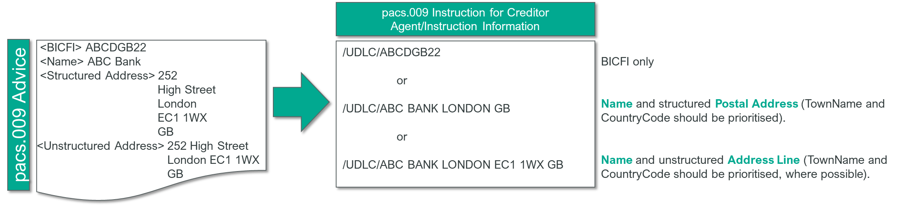
How to correct the pacs.009 message and use the UDLC Codeword ?
UDLC is a code word used to identify the Underlying Creditor (UDLC) in a pacs.009 CORE used for cover settlement of a pacs.009 ADV. The last available occurrence of Instruction Information in the ‘Instruction for Creditor Agent’ element, must be used to capture the Underlying Creditor information provided in the pacs.009 ADV preceded by /UDLC/.
Following this, if the pacs.009 CORE is missing the UDLC codeword, or the UDLC codeword is present but not followed with any data, it is considered invalid by Transaction Manager and the message will be aborted
UDLC is properly captured
process
Transaction Manager would abort the message
Transaction Manager would abort the message
Notes:
During co-existence, some elements in an ISO 20022 message have no equivalent field in MT.
This introduces a challenge where MT messages are created based on the fields from the ISO 20022 message.
To resolve this, a number of coexistence codes have been introduced in Standards Release 2022.
Consequently, there may be challenges with the UDLC codeword in particular.
UDLC indicates Underlying Creditor.
In a scenario where a pacs.009 CORE is used to settle a previously sent pacs.009 ADV,
a special code /UDLC/ has been introduced in Instruction for Creditor Agent to carry information about the underlying creditor
- whether they are identified with a BIC or name and address in a textual format.
The code and following information is translated to field 72 in MT 202 CORE.
Therefore, in addition to other key data elements for matching the Advice with the cover message:
When a “native” pacs.009 - not translated from an MT 202 CORE - covers the funds advised by a pacs.009 ADV from the same agent,
then you must use codeword /UDLC/ in the Instruction for Creditor Agent/Instruction Information data element as per CBPR+ recommendation.
Transaction Manager validates whether /UDLC/ is followed with any data in the Instruction for Creditor Agent/Instruction Information data element.

Slide 36
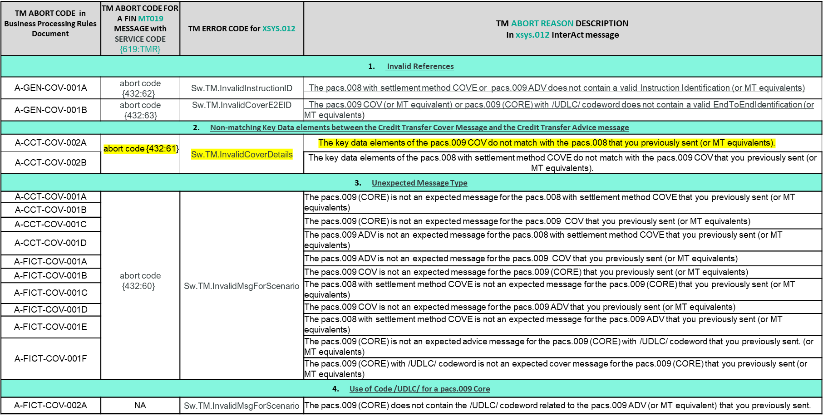
I. Business Validation Rules Where can you find more information on the Reason for a TM Aborts related to TM Business Processing Rules
Example xsys.012 received for a TM Abort :
<Ah:AppHdr xmlns:Ah="urn:swift:xsd:$ahV10">
<Ah:MsgRef>2023-02-07T05:57:06Z</Ah:MsgRef>
<Ah:CrDate>2023-02-07T05:57:06Z</Ah:CrDate>
</Ah:AppHdr>
<Doc:Document xmlns:Doc="urn:swift:xsd:xsys.012.001.01" xmlns:Sw="urn:swift:snl:ns.Sw" xmlns:SwGbl="urn:swift:snl:ns.SwGbl" xmlns:SwInt="urn:swift:snl:ns.SwInt">
<Doc:xsys.012.001.01>
<Doc:DlvryNtfctn>
<Sw:SnFRef>swi00003-2023-02-07T05:57:04.59334.061161Z</Sw:SnFRef>
<Sw:SnFRefType>InterAct</Sw:SnFRefType>
<Sw:AcceptStatus>Rejected</Sw:AcceptStatus>
<Sw:AckSwiftTime>2023-02-07T05:57:06Z</Sw:AckSwiftTime>
<Sw:AckDescription>The key data elements of the pacs.009 COV do not match with the pacs.008 that you previously sent (or MT equivalents).</Sw:AckDescription>
<Sw:AckInfo>SwRejectCode=TM.InvalidCoverDetails;InformCopyName=TMP</Sw:AckInfo>
<SwInt:RequestHeader>
<SwInt:Requestor>ou=xxx,o=sndrbebb,o=swift</SwInt:Requestor>
<SwInt:Responder>ou=xxx, o=rcvrbebb,o=swift</SwInt:Responder>
<SwInt:Service>swift.finplus!pf</SwInt:Service>
<SwInt:RequestType>pacs.009.001.08</SwInt:RequestType>
<SwInt:Priority>Normal</SwInt:Priority>
<SwInt:RequestRef>TM-OCT-AB2-DBTR-COV</SwInt:RequestRef>
</SwInt:RequestHeader>
</Doc:DlvryNtfctn>
</Doc:xsys.012.001.01>
</Doc:Document>
Transaction Manager Operations Guide– Error codes for messages rejected by Transaction Manager
Example MT 019 that you receive for a TM Abort
{1:F01SNDRBEB0AXXX0117087104}{2:O0190957230227DYDYXXXX3XXX00010053542302271057S}{4:{175:1057}{106:230227SNDRBEB0AXXX0117059124}{108:IID/4906.0/82a1}{102:RCVRBEB0XXXX}{432:61}{619:TMR}}{5:{CHK:............}{SYS:1057230227SNDRBEB0AXXX0117059124}{TNG:}}

Slide 37
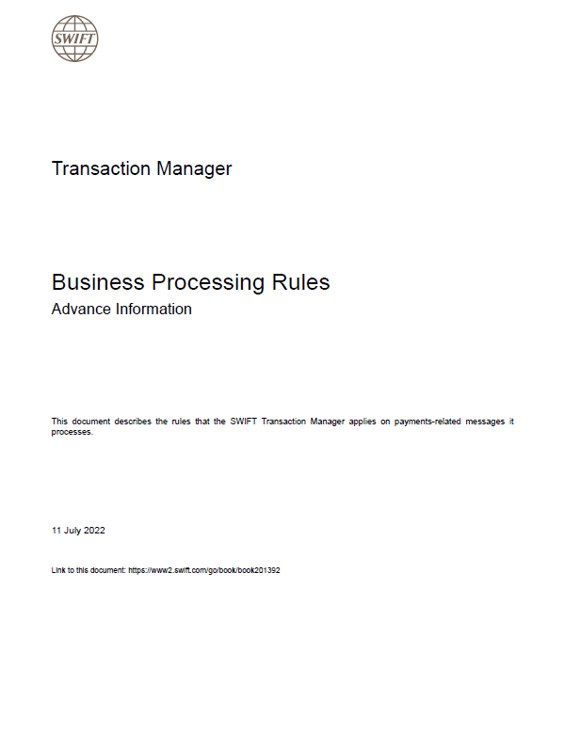
Rule Ref | Business Processing Rules (BPR) section link
I. Transaction Manager Business Processing Rules
This presentation highlights the key requirements that are important to follow to avoid message aborts or bypasses. All the described rules are applicable to both MX and MT-equivalent messages (where the first payment leg on FINplus is in ISO 20022 format) unless otherwise stated.
Business Processing Rules
To find further information about the concepts discussed, you can find the rule reference and link here. You can find use cases that illustrate these rules in the appendix of the BPRs
Business Validation rules
Data Integrity rules
Visibility rules
Notes:
Generally, all of the described rules are applicable to both MX and MT-equivalent messages, with exceptions clearly identified in the dedicated slides. For the Transaction Manager related cases, it is only applicable where the first payment leg on FINplus is in ISO20022 format.
For more details on these rules please consult the Business Processing Rules document. You can find the rule reference and the link to the relevant section of the Business Processing Rules in the top right-hand corner of the slide for each use case. In addition, further illustrations of use cases can be found in the appendix of the Business Processing Rules.

Slide 38
Enterprise Testing Solution

Slide 39
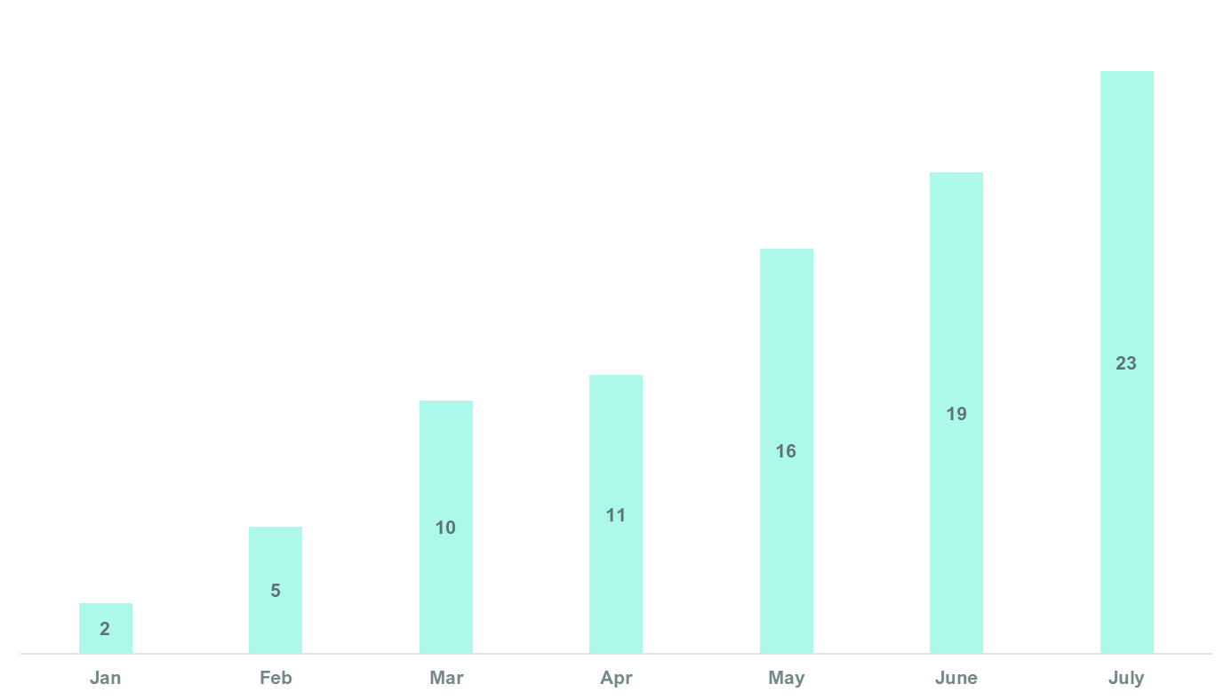
Enterprise Testing Solution for Swift Partners – Adoption to Date
23 Swift Partners leveraging ETS – graph is cumulative and represents partners on-boarding to or testing with ETS

Slide 40
Enterprise Testing Solution for Swift Partners
Provide a stable and rich environment for Swift Partners to test and qualify their products against our messaging and cloud services
In a nutshell:
By leveraging our Enterprise Testing Solution (ETS), Swift partners are now able to interact with the Test Sparring Partner and access the RMA Portal.
ETS provides access to Swift Production Test & Training facilities which enable eligible Swift Partners to test the functionality of Swift products and services in a controlled test environment on our production network.
The solution is optional for Partners and allows them to perform true end-to-end message flow testing.
The Enterprise Testing Solution is currently available to Partners who:
Have a payments application (back-end, core banking, etc.) and wish to test with TSP over FIN / FINPlus
Support clients on-board gpi services
Are on-boarding to Swift Business Connect
Are connectivity solution providers for Swift clients and wish to access the RMA portal
The solution costs are already included in the yearly Swift Partner fee however requires connectivity to Swift network which comes at a cost to the Partner (either through their own connectivity stack or via a connectivity provider)
The solution went live on March 1st and Swift Partners are invited to reach out to provider.readiness@swift.com to register their interest or request further information.

Slide 41


What has changed?
1
Yesterday
Vendor
Applies to Swift Partner Programme
Partner
PIC: PTS Sub-type: PASO
ITB Environment
Dev testing (msg. interface)
Simulated message flow
Today
2
Partner
PIC: PTS Sub-type: PASO
ITB Environment
Dev testing (msg. interface)
Simulated message flow
Vendor
Applies to Swift Partner Programme
Partner
PIC: ETPX
Sub-type: ETPX
ITB Environment
Dev testing (msg. interface)
Simulated message flow
2023 Q3 / Q4 Delivery
Central RMA Portal
gpi TSP catalogue
Securities View TSP catalogue
Prod. T&T Environment
E2E message flow
Test with TSP

Slide 42
Enterprise Testing Solution for Swift Partners – Roadmap
Q1 |  |  |  |  |  |  |  |  |  |  |  | Q2 |  |  |  |  |  |  |  |  |  |  |  | Q3 |  |  |  |  |  |  |  |  |  |  |  | Q4
JAN |  |  |  | FEB |  |  |  | MAR |  |  |  | APR |  |  |  | MAY |  |  |  | JUN |  |  |  | JUL |  |  |  | AUG |  |  |  | SEP |  |  |  | OCT |  |  |  | NOV |  |  |  | DEC
CBPR+
RMA Portal
Alliance Cloud
General Availability
In-Flow Translation
Sanctions Screening
gpi
Securities View
Key Product Availability
TSP Test Catalogue Availability

Slide 43
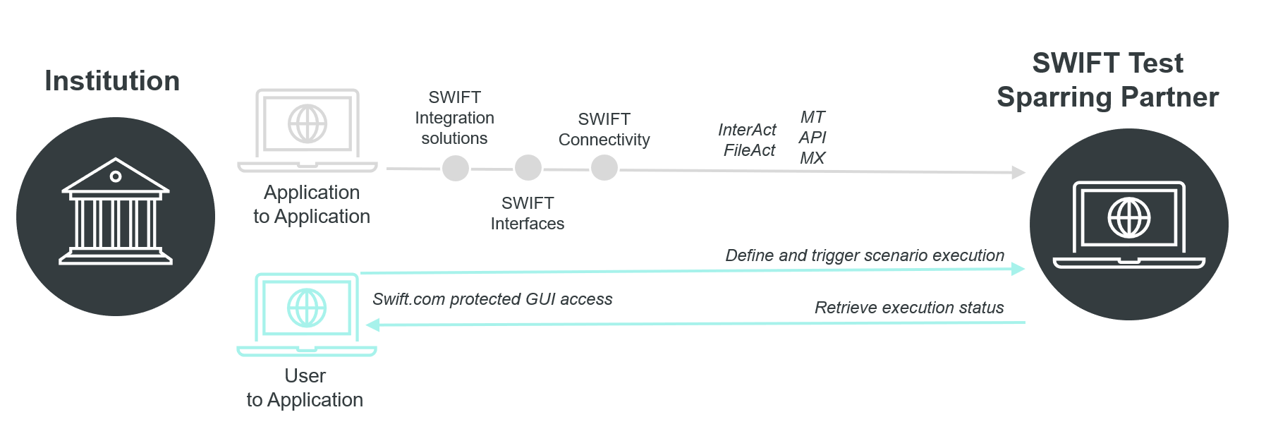

Swift Test Sparring Partner A testing platform that helps Swift Customers and Partners validate their applications when adopting new or changed Swift flows.
For further information on TSP see the Swift Test Sparring Partner publications

Slide 44
Swift Test Sparring Partner
Key features
Real counterparty
Automated testing platform which acts as real counterparties in payment and message flows
Real business flows
Message exchange is not simulated, is network validated and is visible to Tracker, Transaction Manager etc (where applicable)
Functional Test catalogues
Built in test catalogues for different functional domains
Selection of test cases designed to cover the functional domain
Test cases already carry complete data (i.e. are usable out of the box) but can be further customised
Testing management
Built in user and BIC administration, allowing the institutions to manage their test campaigns
Testing strategy
Is intended for facilitation of new service adoption AND for ad-hoc or regression testing to address tester’s specific needs

Slide 45
Register Your Interest
Swift Partners are invited to reach out to provider.readiness@swift.com to register interest in the Enterprise Testing Solution.

Slide 46


Slide 48
If you have any questions, please contact your Account Manager
or raise a case via the Support page

